Slide 1
VotaryTech – Multimedia Image Processing using OpenCV

Slide 2
Objective
To develop and Integrate Image processing technology (Face detection, in this phase) to the real world applications, like capturing the place & subject face information metadata when, user takes the picture.

Slide 3

Requirements and TBD

Slide 4
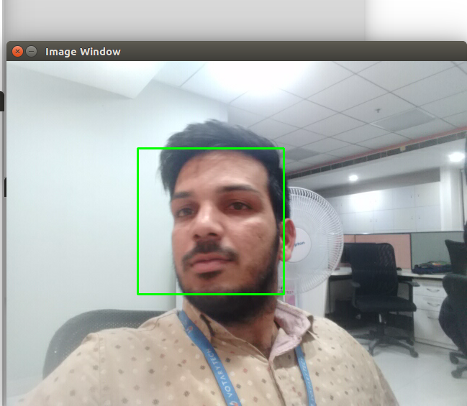
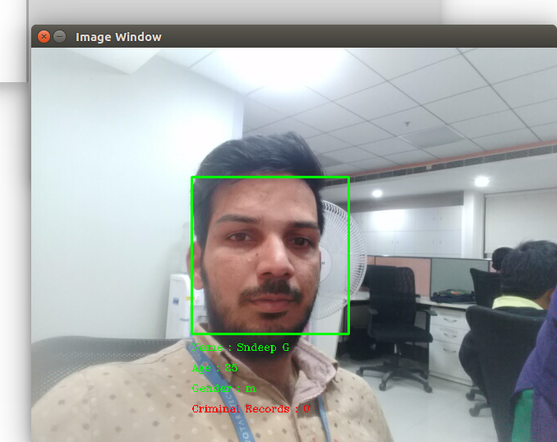
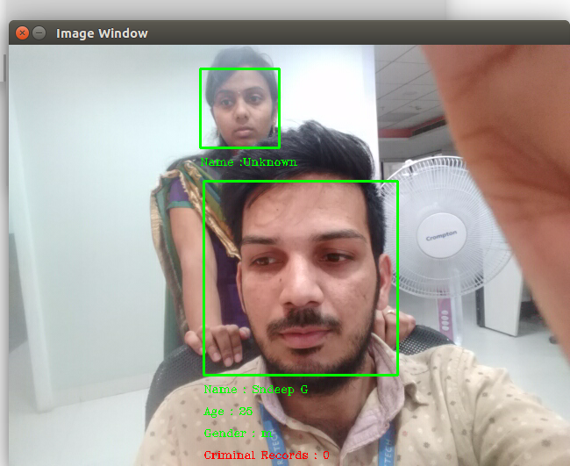
Project output
Recognising a trained Person by
Display the details
Recognising known & Unknown persons
Training a Person

Slide 5
Thank You

